Slide 1


ONLINE EXAMINATION PORTAL
Presented By -
P. Rajesh Babu
Batch – PGDEA 83

Slide 2

CONTENTS
Introduction
Objective
Flowchart
Use Case Diagram
Advantages
Applications
Results
Conclusion

Slide 3

introduction
An online examination Portal is a digital platform designed to administer tests and assessments over the internet.
It allows educators and institutions to create, manage, and conduct exams efficiently, eliminating the need for physical paperwork and in-person supervision.
For students, This system offers the convenience of taking exams from any location with internet access, which can reduce exam-related stress and logistical challenges.

Slide 4

objective
To develop a simple console-based examination management system in C, allowing administrators to create and manage exams, and enabling users to register, log in, and take exams. The system stores user credentials and exam details in files.

Slide 5
FLOWCHART
Start
Load Users & Exams
Main Menu
Admin Login
User Menu
Register User
Admin Menu
Exit Program
Login User
Take Exam
Create Exam
Logout
Exit to Main Menu
Exit to Main Menu

Slide 6
USE CASE DIAGRAM
Admin Login
Admin
Create Exam
Login
Logout
User
Register
Take Exam

Slide 7
Advantages
Convenience And Accessibility
Time Efficiency
Security And Integrity
Time Management
Environmentally Friendly

Slide 8

APPLICATIONS
Educational institutions
Training institutes
Government and public sector
Competitive exam coaching
Online tutoring platforms

Slide 9
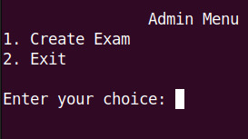
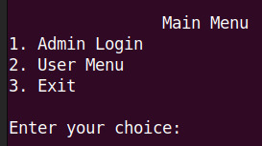
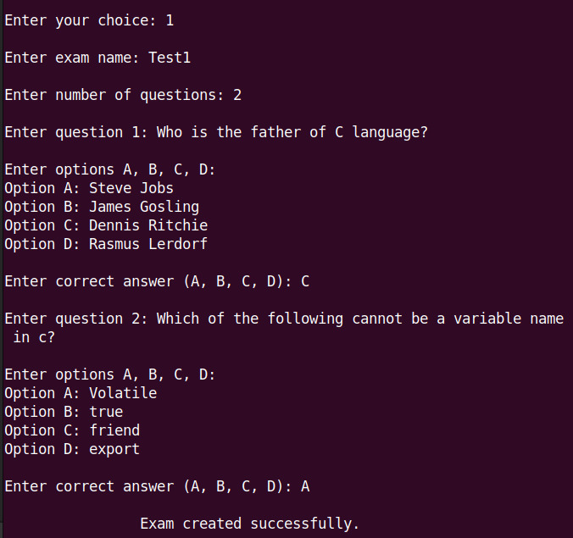
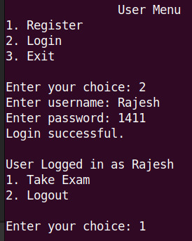
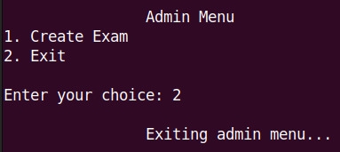
Results

Slide 10
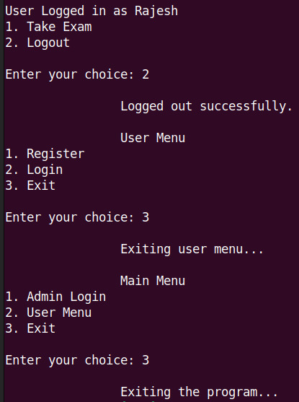
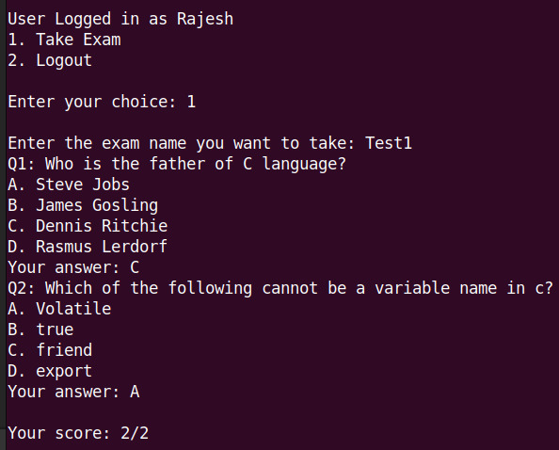

Slide 11

CONCLUSION
The online examination portal is a user-friendly web application designed to digitize exams, reducing paper usage. It streamlines documentation, making information easy to access and accurate.

Slide 12


